Slide 1
Big Data – Amazon Web Services Week 9
Professor Arturo Castellanos, PhD
Assistant Professor – William & Mary
Big Data - MSBA

Slide 2


Components of a Spark Cluster
Each Spark application consists of a driver program and is coordinated by a SparkContext object.
Spark supports various cluster managers including Spark’s standalone cluster manager, Apache Mesos, and Hadoop. The cluster manager allocates resources for applications on the worker nodes.
The executors which are allocated on the worker nodes run the application code as multiple tasks.
When you launch a PySpark shell, a SparkContext is created with the variable name sc.
Chapter 7 - © 2019 Arshdeep Bahga & Vijay Madisetti

Slide 3
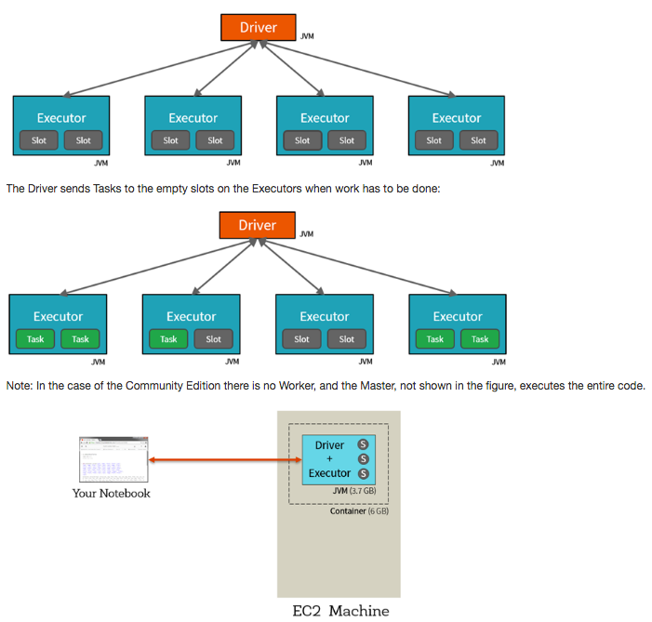
Spark Physical Cluster
At a high level, every Apache Spark application consists of a driver program that launches various parallel operations on executor Java Virtual Machines (JVMs) running either in a cluster or locally on the same machine.

Slide 4
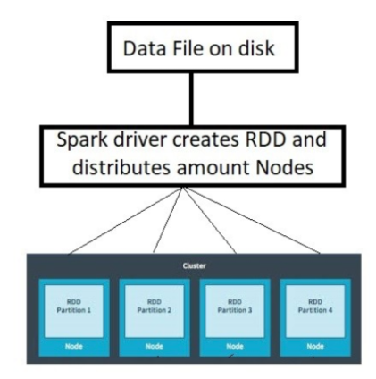
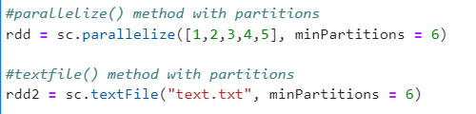
Resilient Distributed Datasets (RDDs)
Resilient: Ability to withstand failures
Distributed: across multiple machines
Datasets: collections of partitioned data (e.g., arrays, tables, tuples)
A partition in spark is a logical division of a large distributed dataset. The number of partitions in an RDD can be found by using getNumParititons()
Chapter 7 - © 2019 Arshdeep Bahga & Vijay Madisetti

Slide 5
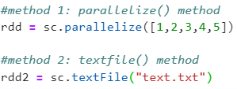

Resilient Distributed Datasets (RDDs)
A collection of data distributed across the cluster.
Data type for PySpark
RDDs can be created either by parallelizing existing collections or by loading an external dataset:
Spark Operations:
Transformations: create a new RDD from an existing RDD.
Actions: return a value to the driver program after running a computation on the dataset
Chapter 7 - © 2019 Arshdeep Bahga & Vijay Madisetti

Slide 6
Install Spark in Anaconda Terminal
We will create a new environment in Anaconda and Install the necessary libraries.
Open Anaconda Prompt (shell) in Admin mode.
Run the following commands (one at a time). If conda does not work, replace with pip:
conda create --name pyspark conda activate pyspark conda install python conda install pypandoc conda install pyspark conda install jupyterlab conda install pandas conda install matplotlib pip install pyspark-dist-explore
Once you ran these commands successfully, enter:
jupyter lab
Upload the Spark Notebook to your Jupyter lab

Slide 7
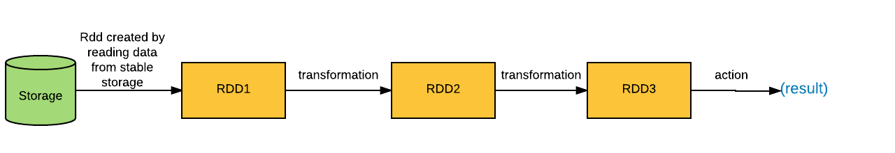
RDD Lazy Evaluation
Spark creates a DAG (graph), of all operations you perform on an RDD. Execution of the graph starts only when an action is performed on RDD.
Source: https://www.oreilly.com/library/view/apache-spark-2x/9781787126497/f1c4785d-fea7-4948-89f6-f3cb70f7e006.xhtml
In this example, an RDD is calculated by reading data from a stable storage and two of the transformations are performed on the RDD and then finally an action is performed to get the result.
Basic RDD transformations: map(), filter(), flatMap(), and union()
Chapter 7 - © 2019 Arshdeep Bahga & Vijay Madisetti

Slide 8
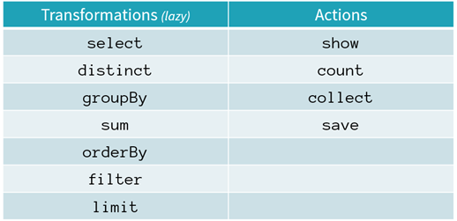
Transformations and Actions:
Transformations are operations that will not be completed at the time you write and execute the code in a cell - they will only get executed once you have called a action.
Actions are commands (tasks) that are executed by Spark at the time of their execution

Slide 9
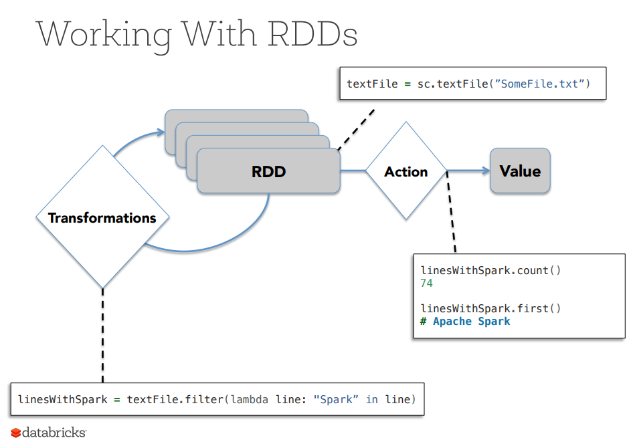

Slide 10
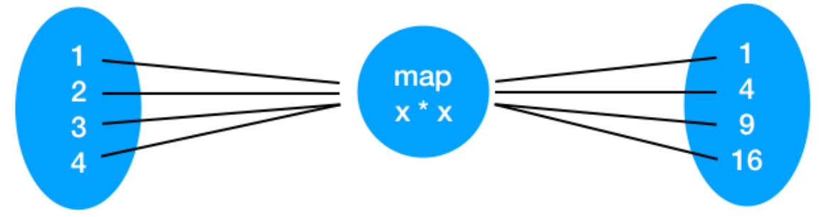

map() transformation
We first create an RDD using SparkContext's parallelize method on a list containing elements 1,2,3,4. Next, we apply map transformation for squaring each element of the RDD.
A map() transformation takes in a function and applies it to each element in the RDD. In the resulting RDD, the square function is applied to each element of the RDD.
Source: Assigned Datacamp module (PySpark)

Slide 11
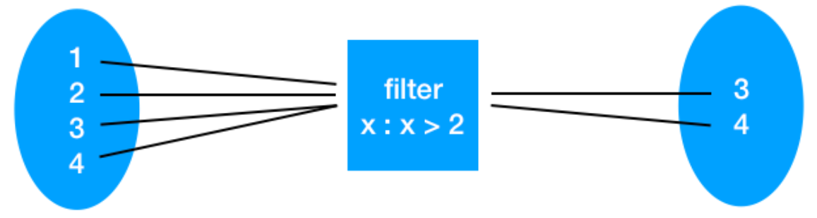
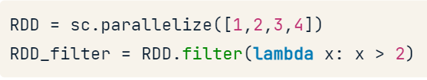
filter() transformation
A filter transformation takes in a function and returns an RDD that only has elements that pass the condition.
Suppose we have an input RDD with numbers 1,2,3,4 and we want to select numbers greater than 2, we can apply the filter transformation.
Source: Assigned Datacamp module (PySpark)

Slide 12
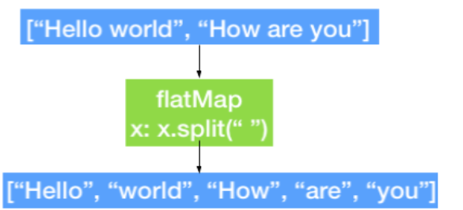

flatMap() transformation
A flatMap transformation is similar to map transformation except it returns multiple values for each element in the source RDD. A simple usage of flatMap is splitting up an input string into words.
Source: Assigned Datacamp module (PySpark)

Slide 13
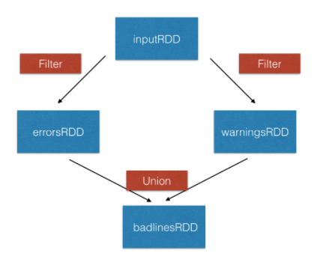

union() transformation
A union transformation returns the union of one RDD with another RDD.
Source: Assigned Datacamp module (PySpark)

Slide 14

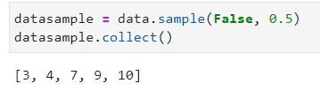
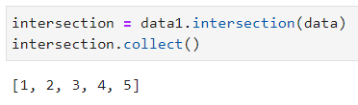
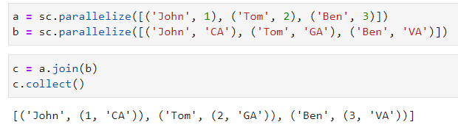
Other transformations
sample(): samples the data with or without replacement
intersection(): generates a new dataset from the intersection of two datasets
join(): generates a new dataset by joining two datasets containing key-value pairs.
Source: Assigned Datacamp module (PySpark)

Slide 15

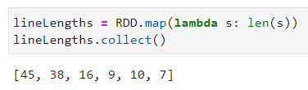
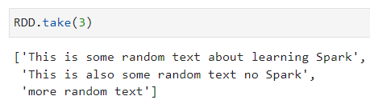

Spark Actions
collect(): return all the elements of the dataset as an array
take(N): returns an array with the first N elements of the dataset
first(): prints the first element of the RDD
Source: Assigned Datacamp module (PySpark)

Slide 16

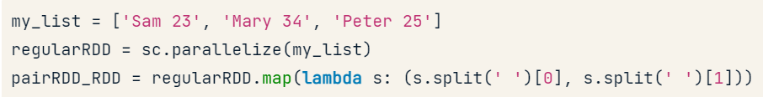
Pair RDDs (Key-value pairs)
Is a special data structure with a key (identifier) and a value. Two ways of creating an RDD are:
(1) From a list of key-value tuple:
(2) From a regular RDD

Slide 17
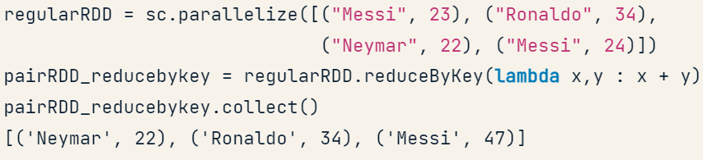
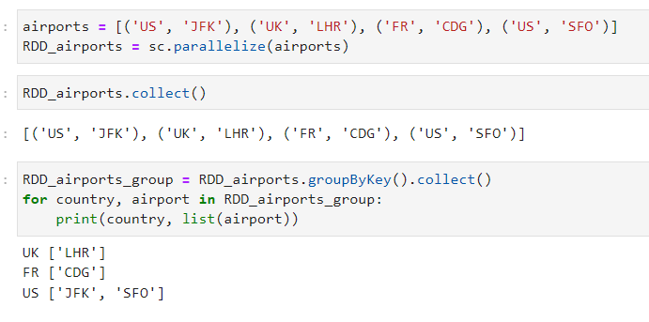
Examples of paired RDD Transformations
reduceByKey(): combine values with same key.
groupByKey(): group values with the same key

Slide 18
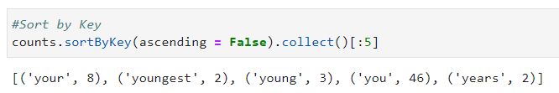
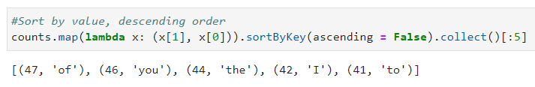
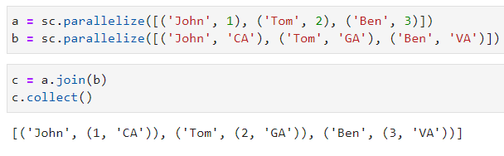
Examples of paired RDD Transformations
sortByKey(): return an RDD sorted by the key
join(): join two pair RDDs based on their key

Slide 19
Spark SQL – PySpark DataFrames
PySpark SQL is a Spark component that enables interactive querying of data using SQL queries
DataFrames in PySpark support both SQL queries (SELECT * FROM TABLE) or expression methods (df.select())
SparkContext allows you to create RDDs, similarly SparkSession allows you to interact with Spark DataFrames.
SparkSession can be used to create a DataFrame or execute SQL queries
Two different methods to create a DataFrame:
From existing RDDs using createDataFrame()
Read from data source (CSV, JSON, TXT) using read method
Chapter 7 - © 2019 Arshdeep Bahga & Vijay Madisetti

Slide 20
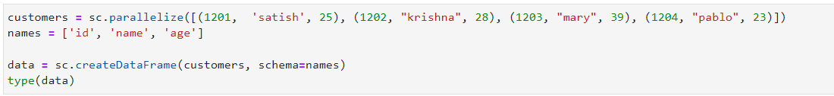
Create a DataFrame from RDD
Spark SQL is a Spark component that enables interactive querying of data using SQL queries
When running SQL from within another programming language the results will be returned as a Dataset/DataFrame.
Unlike the basic Spark RDD API, the interfaces provided by Spark SQL provide Spark with more information about the structure of both the data and the computation being performed.
Chapter 7 - © 2019 Arshdeep Bahga & Vijay Madisetti

Slide 21
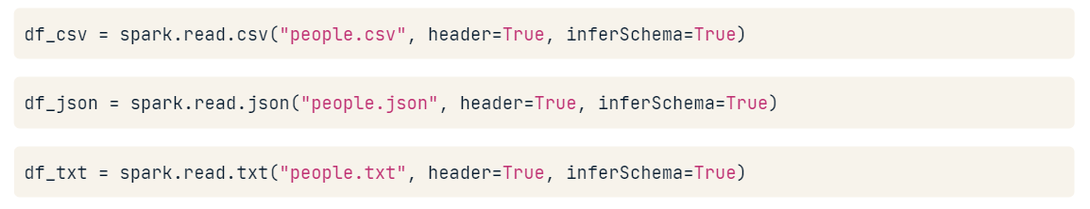
Create a DataFrame from reading a CSV/JSON/TXT
inferSchema will try to assign the correct data types to the DataFrame
DataFrame Operations: select(), filter(), groupby(), orderby(), dropDuplicates(), withColumnRenamed()
DataFrame Actions: head(), show(), count(), columns(), and describe()
DataFrame Methods: printSchema()
Source: Assigned Datacamp module (PySpark)

Slide 22
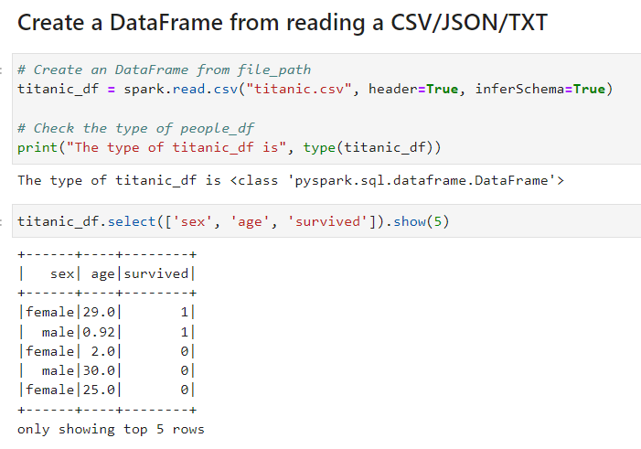
select() and show() operations
select() subsets the columns in the DataFrame
show() prints first 20 rows in the DataFrame
Source: Titanic dataset from Kaggle

Slide 23
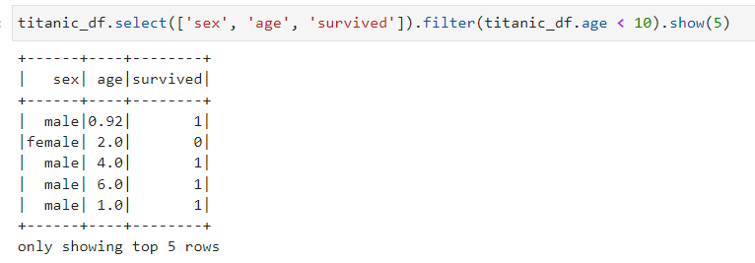
filter() and show() operations
filter() filters out the rows based on a condition
show(5) prints first 5 rows in the DataFrame
Note that you can chain operations
Source: Titanic dataset from Kaggle

Slide 24
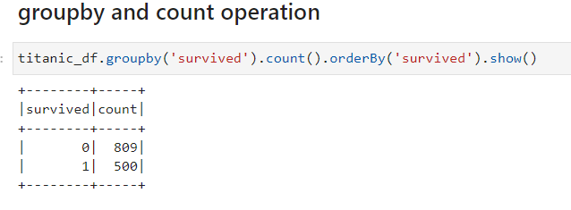
groupby(), count(), orderby() operations
groupby() is used to group a variable
count() returns the total number of rows in the DataFrame
orderby() sorts the dataframe based on one or more columns
Note that you can chain operations
Source: Titanic dataset from Kaggle

Slide 25
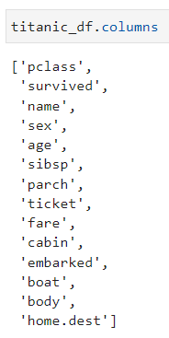
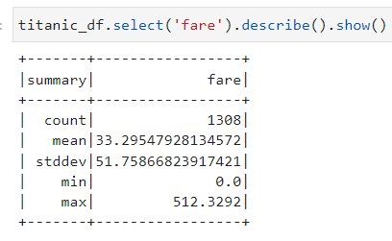
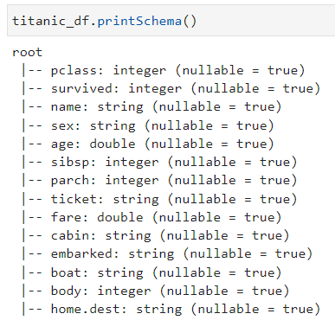
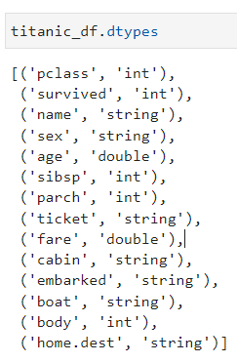
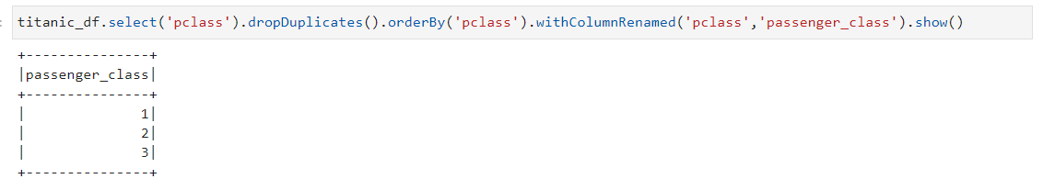
Other operations/actions
Source: Titanic dataset from Kaggle

Slide 26
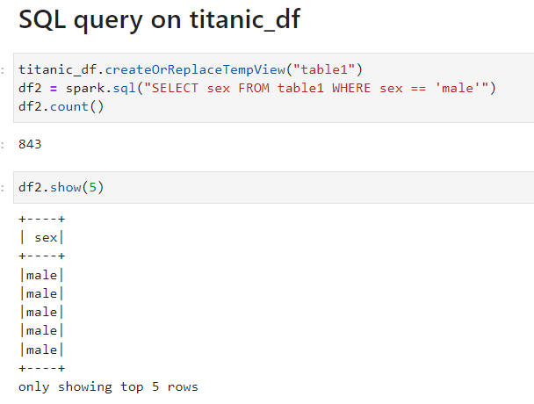
Executing SQL Queries
The SparkSession provides a method called sql which can be used to execute a SQL query.
The sql method takes a SQL statement as an argument and returns a DataFrame representing the result of the given query.
Unfortunately, SQL queries cannot be run directly against a DataFrame. To issue SQL queries against an existing DataFrame we can leverage the createOrReplaceTempView function to build a temporary table
After creating the temporary table, we can simply use the sql method, which allows us to write SQL code to manipulate data within a DataFrame.

Slide 27
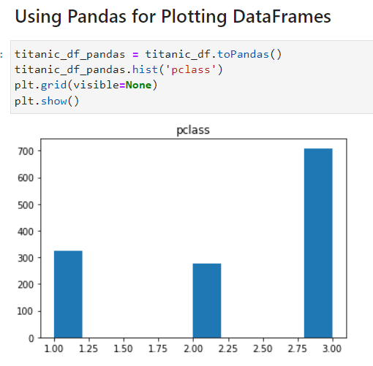
Data Visualization in PySpark
Pyspark_dist_explore. 3 native methods in PySpark:
hist()
distplot()
pandas_histogram()
Note you can use open source data visualization tools such as Matplotlib, Seaborn, Bokeh, but not natively, you would need to convert your PySpark DataFrame to Pandas.
Difference between Pandas dataframe and PySpark DataFrame
Pandas DataFrames are in-memory and single-server. PysPark run in parallel
In Pandas, results are generated as soon as we apply and operation, whereas in PySpark, we have lazy evaluation
Pandas dataframes are mutable, whereas PySpark DataFrames are immutable
Pandas API support more operations that PySpark DataFramews

